Slide 1

SPECTRE MK0
December 9, 2022
Miles Osborne

Slide 2
Presentation Overview
Spectre Introduction
Spectre MK0 Project
Design
Demo
Conclusion

Slide 3
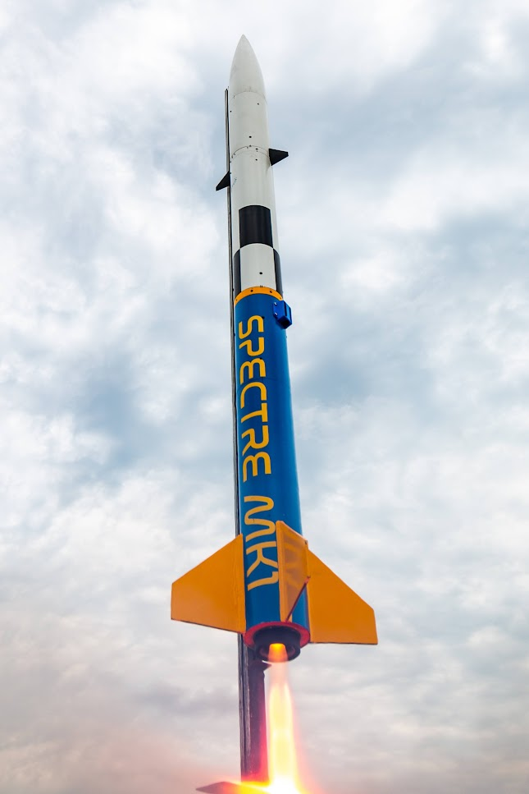
Spectre MK1
Project Overview
Experimental high-powered actively stabilized rocket
Objective: Vertical, roll-less flight
99 inches tall
5.5 inches in diameter,
Apogee ranging from 5000 to 7000 feet.
Payload: Spectre Module FC/Active stabilization unit

Slide 4
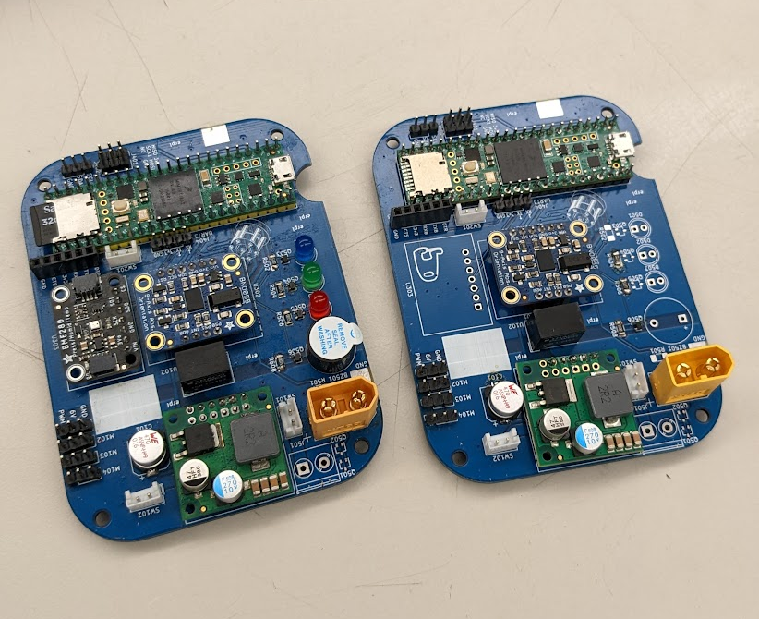
Spectre MK0
An attempt to recreate the basic features of the Spectre Module flight computer used for the actual flight vehicle(s).
Not a 1-to-1 recreation
Simple goal to actuate the canards based on raw orientation
No plans to use this on a flight vehicle.

Slide 5
System Features
Features | Spectre Mk1 | Spectre MK0
Development Board | Teensy 4.1 MCU | Nexys A7-100T FPGA
Servo Motors | 2x LD-20MG | 2x LD-20MG
Sensors | BNO055 IMU BME280 Pressure Sensor ADXL377 High-G accelerometer | ADXL362 Accelerometer
Power Supply | 1x 3s lipo battery | 5v usb 7v DC power supply
Data Filtering | Kalman Filter | None
Canard Actuation | YES | YES*

Slide 6
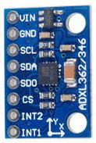

Project Timeline (Original)
1. Get data from accelerometer
2. Confirm servo control is possible
3. Filter accelerometer data
4. Develop simple PID or PD controller
5. Actuate servos based on error from upright orientation
NOTE: THIS DID NOT HAPPEN!

Slide 7
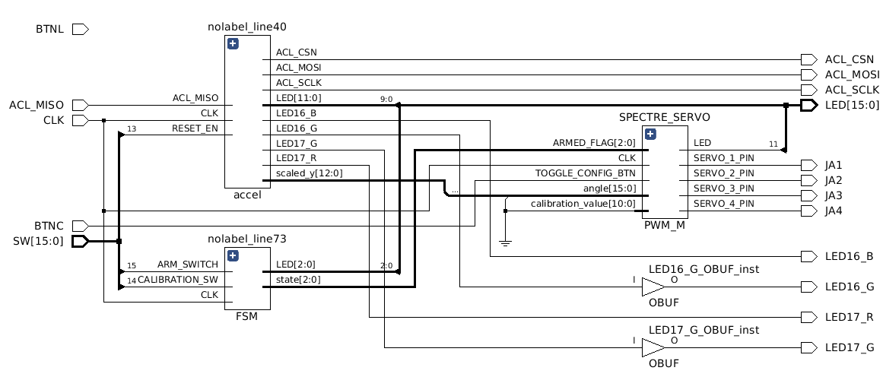
Modules
4 Modules
Spectre_MK0_Main
Accel
FSM
PWM

Slide 8
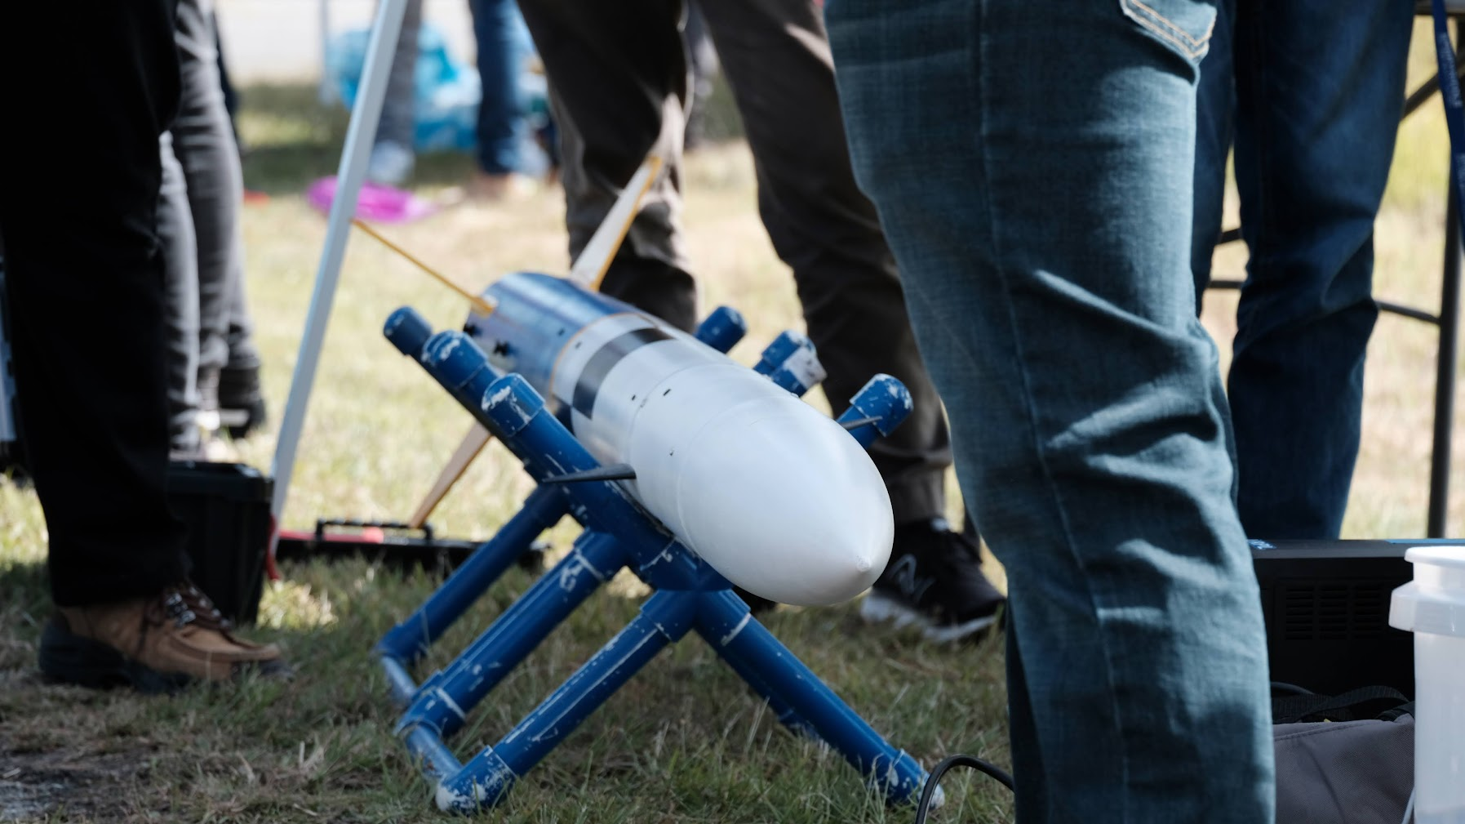
Challenges
Getting output from the GPIO pins
Properly configuring PWM to the right settings
Properly scaling the accelerometer values
Time…..
Servo calibration
Also I broke (more) things :)

Slide 9
Flight 2 Video & Demo
Link: https://photos.app.goo.gl/uD9Gk1Ujg4X857UX8

Slide 10



Special Thanks

Slide 11
Questions?

